Slide 1
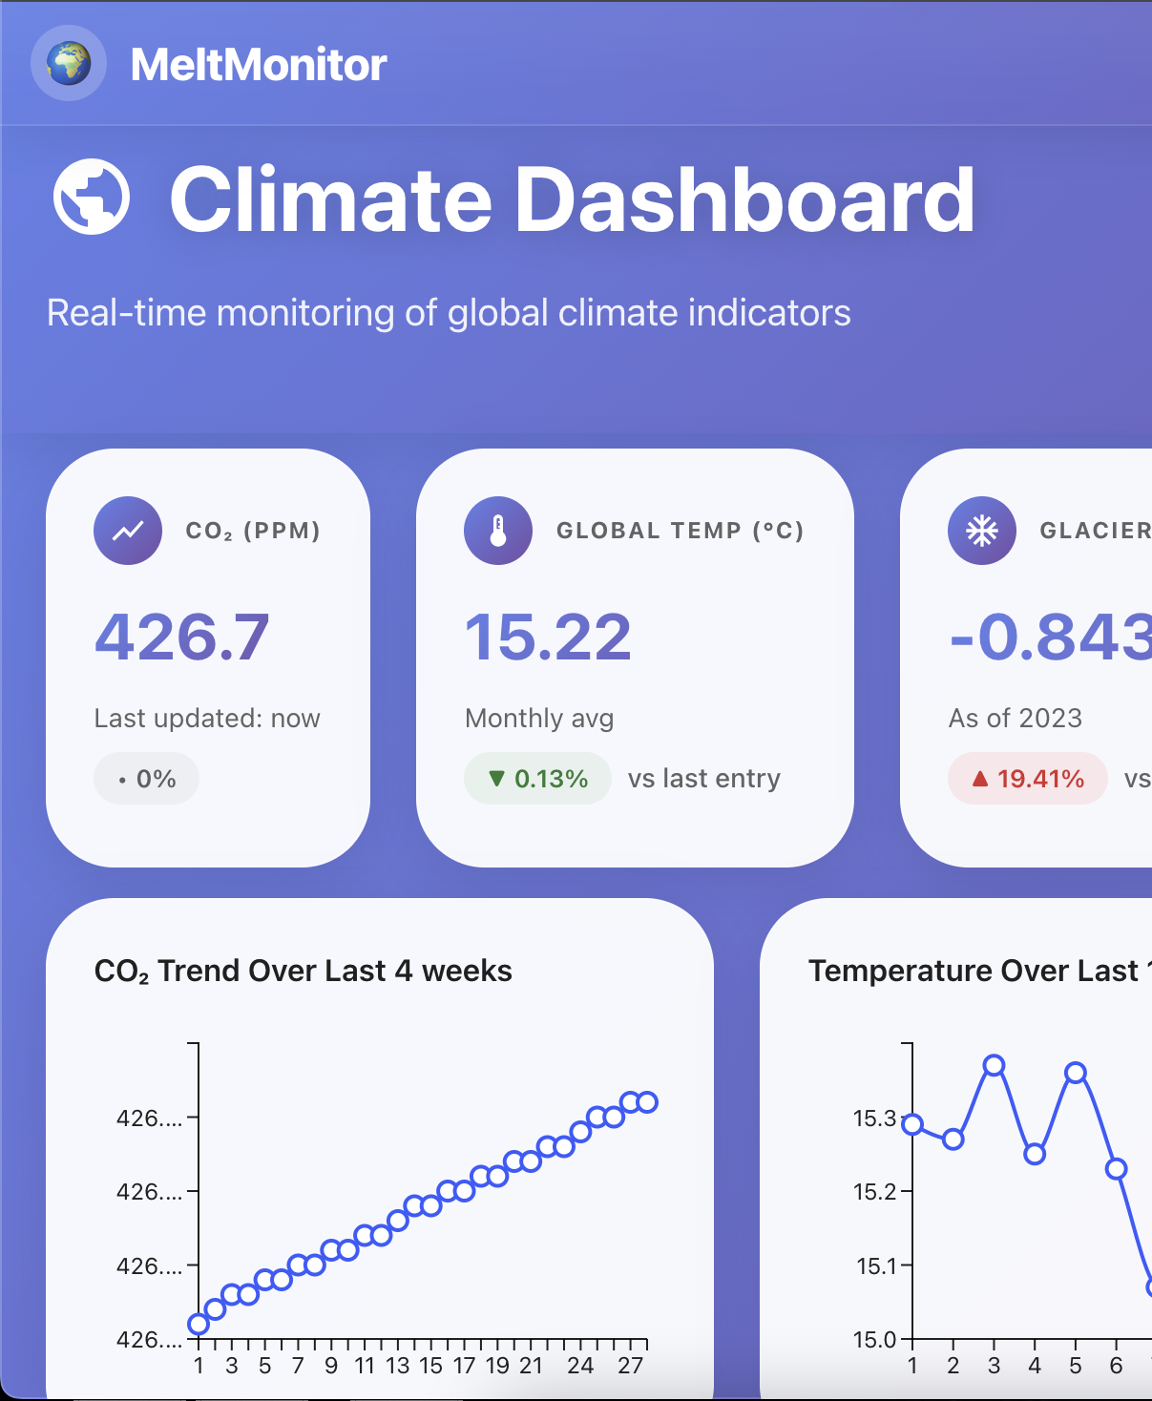
Melt
Monitor
By Soham Bhowmick, Chance Kissel, Paul Lewis Marcos, Lwin Moe
December 4th, 2025
CS160 Sec 03 Team 6
Notes:
Intro (Everyone)

Slide 2




Meet the Team
Soham Bhowmick
Chance Kissel
Paul Lewis Marcos
Lwin Moe
Interactive Map Lead
Live Data Fetching Lead
Database Lead
UI/UX Lead
Notes:
Intro (Everyone)

Slide 3


Objective + Target Audience
We wanted to create a web application that would visualize the relationships between global fluctuations of CO₂ levels, temperature, and glacier mass loss.
MeltMonitor is intended to be used as an educational tool for an easier understanding of how these components interact in regard to climate change.
Persona 1: Jack
Persona 2: Laura
Jack is an administrator for an automotive company. Jack wants to keep track of global CO₂ emissions growth for a presentation on moving the company towards green energy.
He needs an easy way to see updated daily values.
Laura is a school teacher who wants to have her students learn more about climate change.
She needs a place that makes it easy to understand how CO₂ and Temperature can affect Glacier health
Notes:
Chance

Slide 4








Tech Stack
To bring this product together we used:
Frontend
React 18
Vite 5
React Router 6
UI Framework
Material UI 6
MUI X Charts
Data Processing
Papa Parse
Custom ML algorithms
Languages
JavaScript
HTML
CSS
Maps
GeoJSON
SVG-based choropleth
Styling
MUI theming
CSS-in-JS
Tailwind
Build
Vite
ESLint
PostCSS
Notes:
Chance

Slide 5
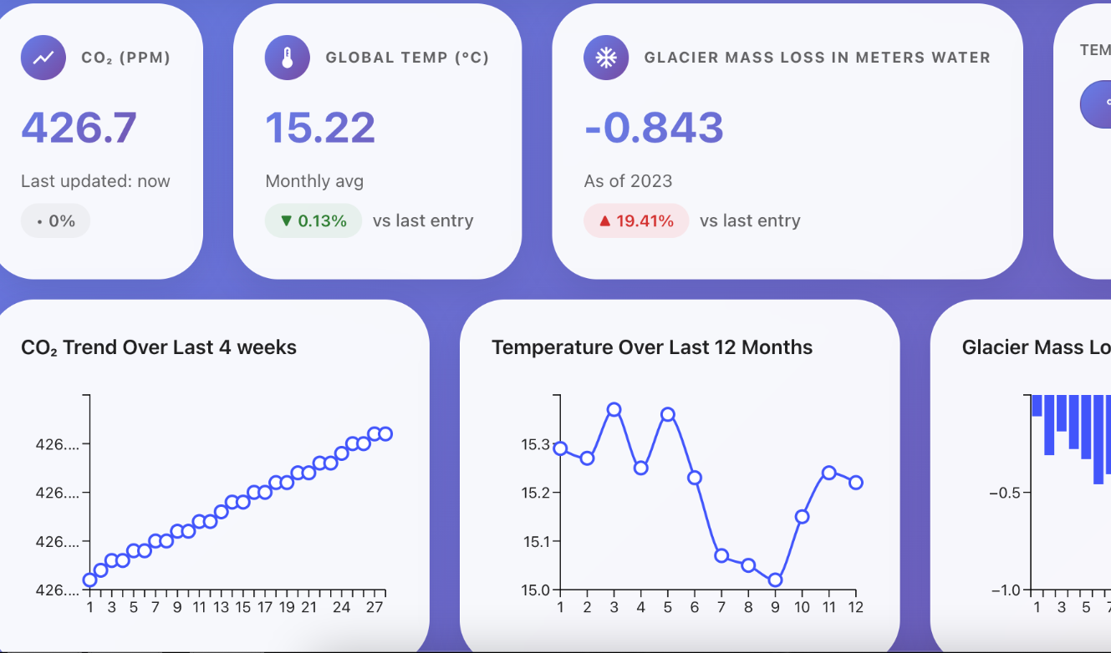
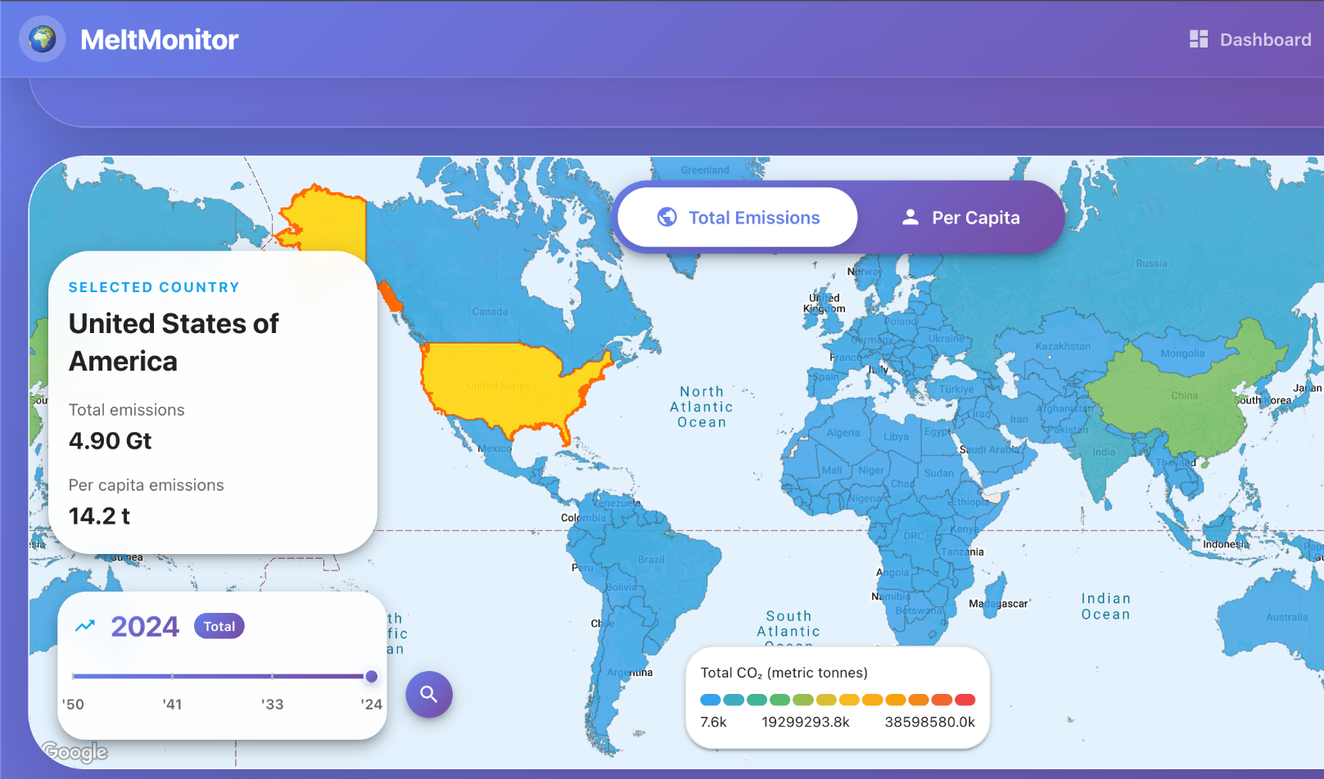
What Are Our Major Features?
Main dashboard
Interactive global map Page
Learning Center Page
Profile Page
Sources page
Notes:
Chance

Slide 6
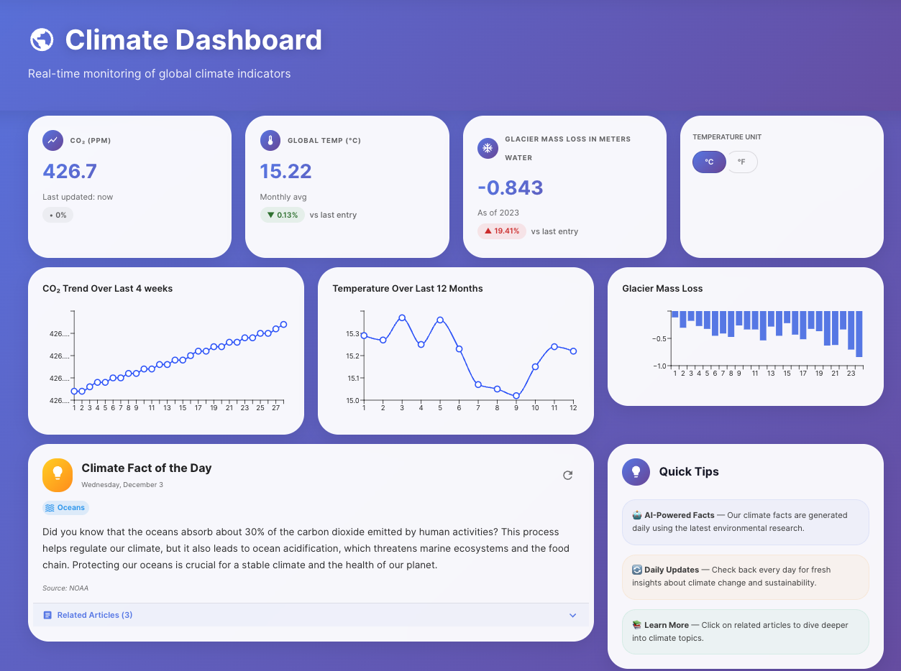
Main Dashboard
The main dashboard consists:
CO₂ in Parts Per Million (PPM) (Statistic + Trend Chart)
Temp in C° or F° (Statistic + Trend Chart)
Glacier Mass Loss in meters water equivalent (m.w.e) (Statistic + Trend Chart)
Unit Toggle: Convert between C° or F°
Climate Fact: Daily AI generated climate fact
Quick Tips: AI generated tips about the application
Notes:
Lwin

Slide 7
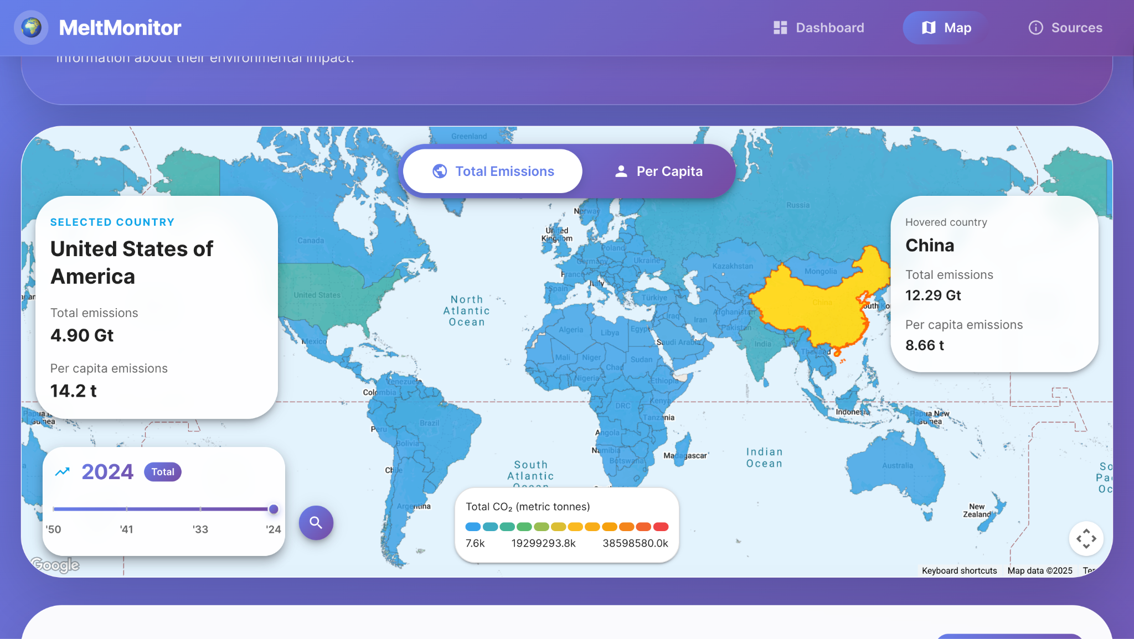
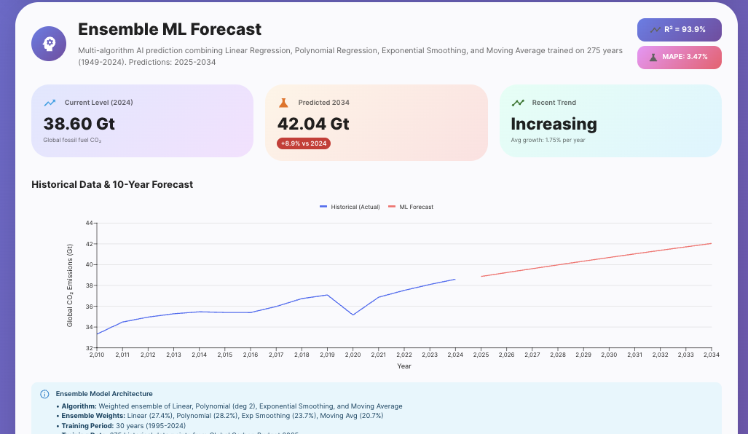
2. Interactive Global Map + ML Forecasting
Interactive Map
What It Does:
Visualizes CO₂ emissions for 258 countries (1949-2024).
Two metrics: Total emissions (Gt) or per capita (t/person).
ML Forecasting
What It Does:
Predicts global CO₂ emissions for the next 10 years (2025-2034)
Current: 38.60 Gt → Predicted 2034: 42.04 Gt (+8.9%)
Uses 4 ML algorithms combined: Linear, Polynomial, Exponential Smoothing, Moving Average
Notes:
Lwin

Slide 8
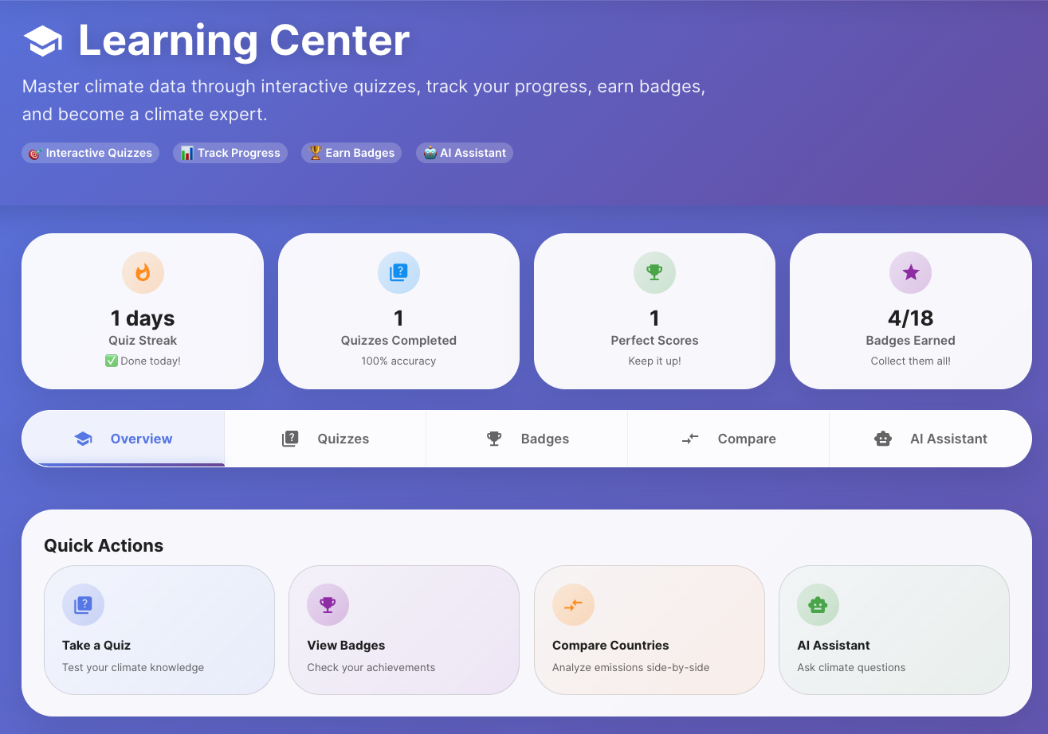
3. Learning Center
Personalized Components
Streaks, Quizzes, Scores, Badge Progress
Tabs
Quizzes
Compare: stats for different counties
AI Assistant: to help further assist learning needs
Quick Actions
Faster navigation around the site
Notes:
Lwin Change

Slide 9
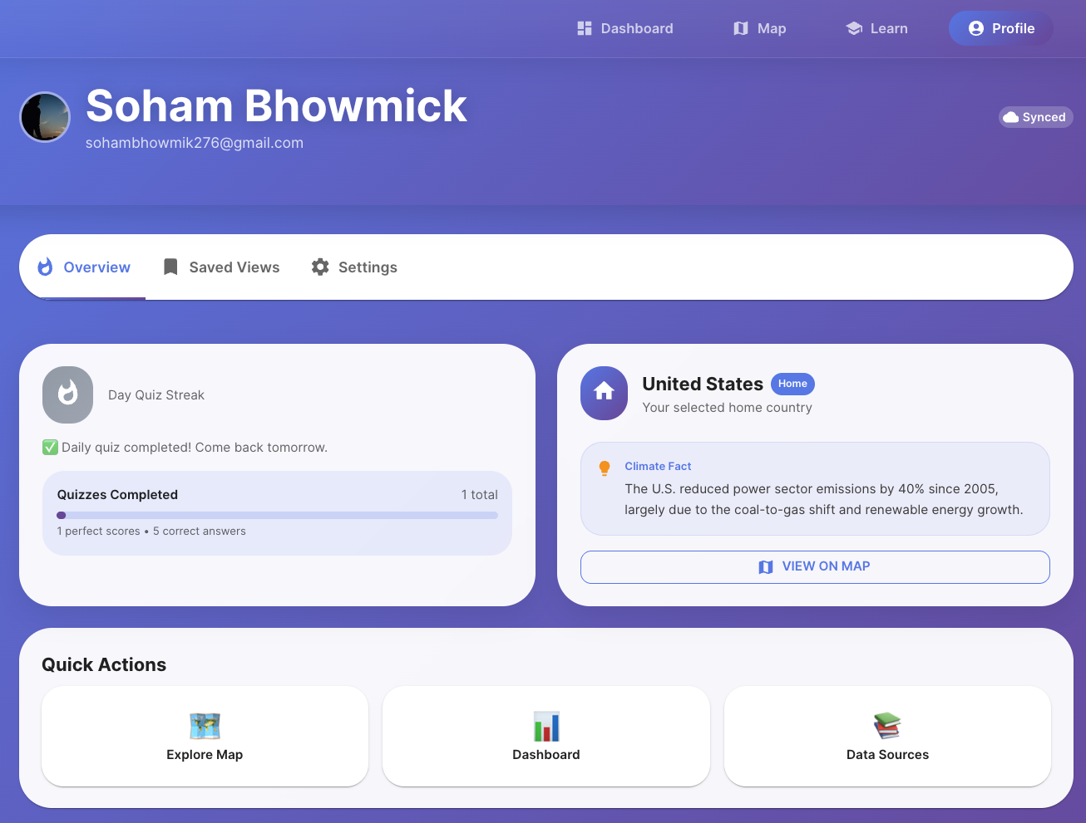
4. User Profile
What User Profile consists of:
Overview
Saved Views
Settings
Overview
Streak Quiz
Home Country
Quick Climate Fact
Quick Actions
What Does It Provide:
For getting around
Map, dashboard, sources
Notes:
Paul
Change

Slide 10
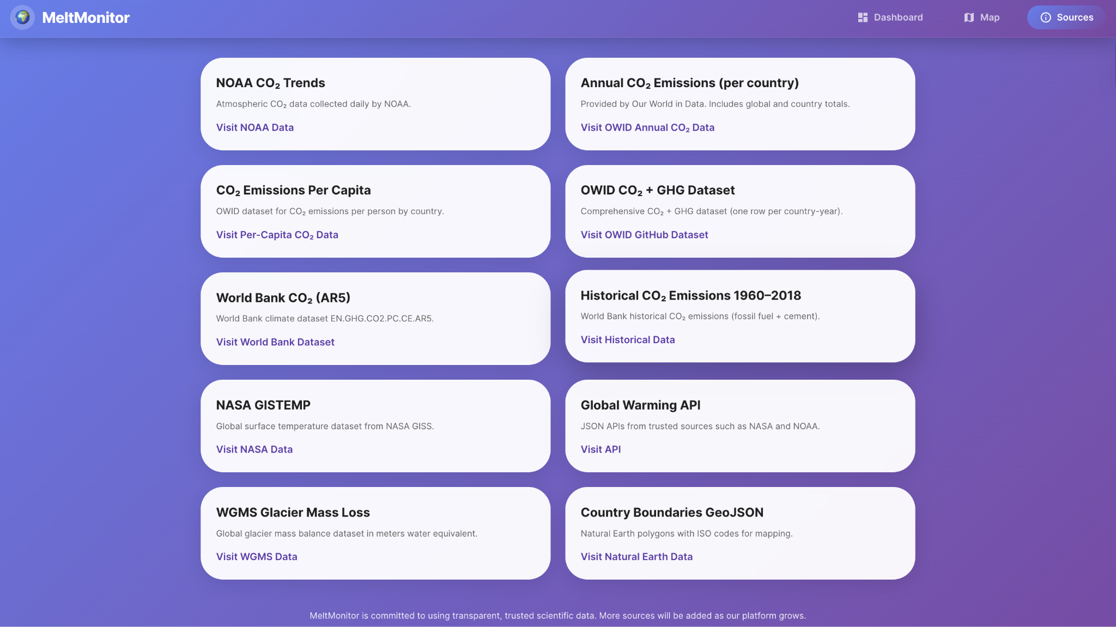
5. Sources Page
What Is It For: The sources page located at the far right of the navigation bar is to give proper citation to the data sources we are pulling from.
What Does It Provide: It includes embedded links to each resource, allowing users to visit each native site to learn more about individual statistics.
Notes:
Paul

Slide 11
DEMO

Slide 12
What Problems Did We Run Into? & Future Improvements
Live Fetching for Glacier Data
Visualization on Data
Workflow
We could not find any credible sources that regularly update an API for glacier mass loss. This had to be changed to reading from a periodically updated CSV.
It took us a while to settle on how our data would look and on what components we would use.
Because of vastly different schedules, team coordination would be a little tough. Keeping a consistent design took time.
Mobile Platform
Climate Statistics
Educational Modules
In the future we hope to move this project in the mobile space to further have a bigger impact.
In the future we could add additional data sets like sea-level rise and methane emissions.
By adding explanations and more interactive lessons, we hope to strengthen Melt Monitor as a teaching tool.
Notes:
Paul

Slide 13
Q & A

